Slide 1
CS4104 Applied Machine Learning
Dimensionality Reduction

Slide 2
Dimensionality Reduction
The input space of many learning problems is of high dimensionality
This has computational implications and, it makes finding the intrinsic information content difficult
Context: unsupervised learning
given a collection of data points in an n-dimensional space a good representation of the data in r-dimensional

Slide 3

Dimensionality Reduction
m examples; n dimensional space
$X=\left[\begin{matrix}x_{11} & ⋯ & x_{1n} \\ ⋮ & ⋱ & ⋮ \\ x_{m1} & ⋯ & x_{nm}\end{matrix}\right]$
The dimensionality reduction is to reduce dimensions n to r
$X=\left[\begin{matrix}x_{11} & ⋯ & x_{1r} \\ ⋮ & ⋱ & ⋮ \\ x_{m1} & ⋯ & x_{nr}\end{matrix}\right]$

Slide 4
Dimensionality Reduction Techniques
Visualize, categorize, or simplify large datasets
Principal Component Analysis (PCA): Finds the dimensions that capture the most variance
Multidimensional Scaling (MDS): Finds data points in lower dimensional space that best preserves the inter-point distance.
Isomap: Estimates the distance between two points on a manifold by following a chain of points with shorter distances between them. (More accurate in representing global distances than LLE; slower than LLE)
Local Linear Embedding (LLE): Only worries about representing the distances between local points. Faster than Isomap (no worry about global distances)
Decision Tree based Selection

Slide 5
Feature Selection
In many applications, we often encounter a very large number of potential features that can be used
Which subset of features should be used for the best classification?
Need for a small number of discriminative features
To avid “curse of dimensionality”
To reduce feature measurement cost
To reduce computational burden
Given an nxd pattern matrix (n patterns in d-dimensional feature space), generate an nxm pattern matrix, where m << d

Slide 6
Feature Selection vs. Extraction
Both are collectively known as dimensionality reduction
Selection: choose a best subset of size m from the available d features
Extraction: given d features (set Y), extract m new features (set X) by linear or non-linear combination of all the d features
Linear feature extraction: X = TY, where T is a mxd matrix
Non-linear feature extraction: X = f(Y)
New features by extraction may not have physical interpretation/meaning
Examples of linear feature extraction
Unsupervised: PCA; Supervised: LDA/MDA
Criteria for selection/extraction: either improve or maintain the classification accuracy, simplify classifier complexity

Slide 7
Feature Selection
How to find the best subset of size m?
Recall, best means classifier based on these m features has the lowest probability of error of all such classifiers
Simplest approach is to do an exhaustive search; computationally prohibitive
For d=24 and m=12, there are about 2.7 million possible feature subsets! Cover & Van Campenhout (IEEE SMC, 1977) showed that to guarantee the best subset of size m from the available set of size d, one must examine all possible subsets of size m
Heuristics have been used to avoid exhaustive search
How to evaluate the subsets?
Error rate; but then which classifier should be used?
Distance measure; Mahalanobis, divergence,…
Feature selection is an optimization problem

Slide 8

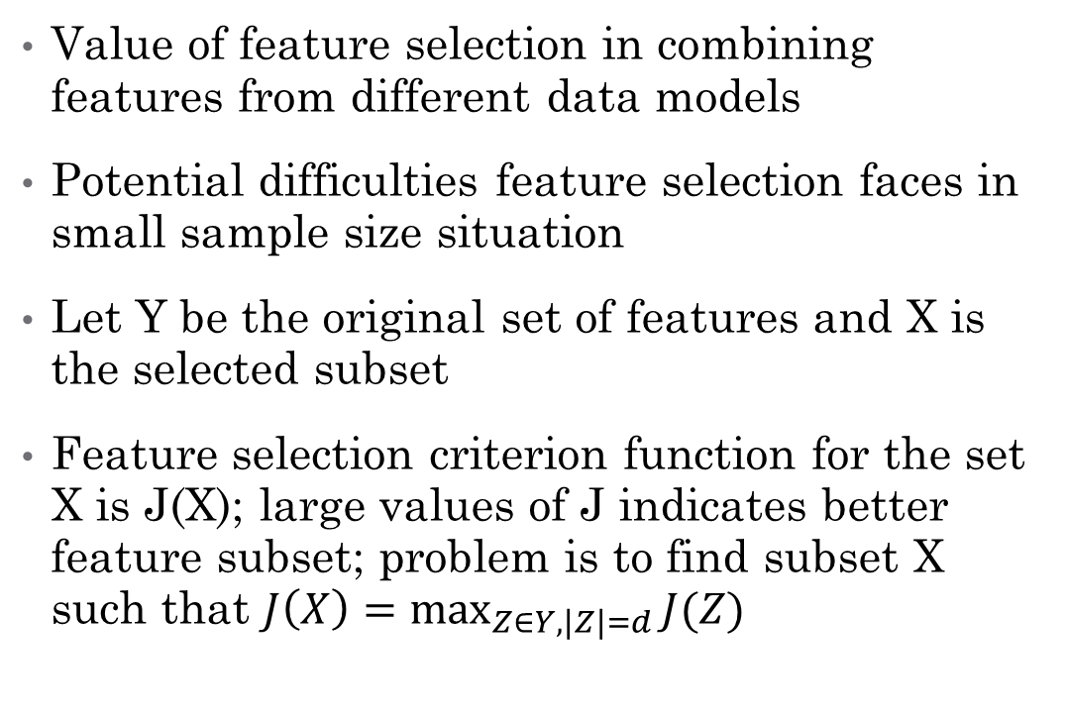
Feature Selection: Evaluation, Application, and Small Sample Performance (Jain & Zongker, IEEE Trans. PAMI, Feb 1997)
Value of feature selection in combining features from different data models
Potential difficulties feature selection faces in small sample size situation
Let Y be the original set of features and X is the selected subset
Feature selection criterion function for the set X is J(X); large values of J indicates better feature subset; problem is to find subset X such that $J\left(X\right)=\max_{Z∈Y, \left|Z\right|=d}{J(Z)}$

Slide 9
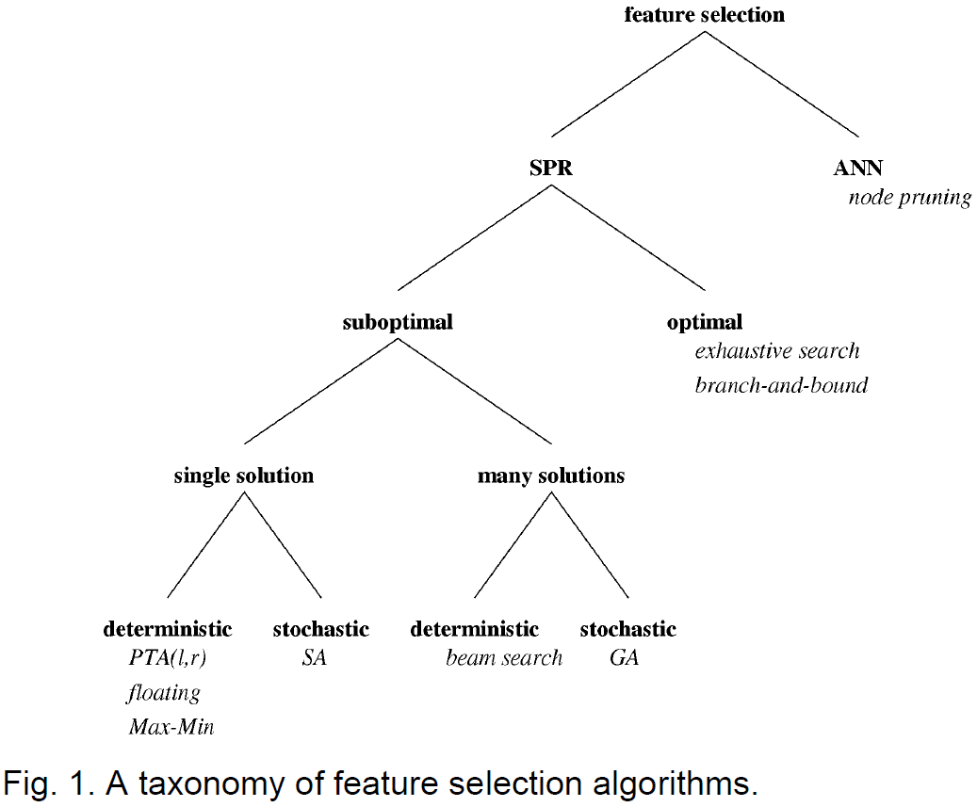
Taxonomy of Feature Selection Algorithms

Slide 10
Deterministic Single-Solution Methods
Begin with a single solution (feature subset) & iteratively add or remove features until some termination criterion is met
Also known as sequential methods; most popular
Bottom up/forward methods: begin with an empty set & add features
Top-down/backward methods: begin with a full set & delete features
Since they do not examine all possible subsets, no guarantee of finding the optimal subset
Pudil introduced two floating selection methods: SFFS, SFBS
15 feature selection methods listed in Table 1 were evaluated

Slide 11
Sequential Forward Selection (SFS)
Start with empty set, X=0
Repeatedly add most significant feature with respect to X
Disadvantage: Once a feature is retained, it cannot be discarded; nesting problem

Slide 12
Sequential Backward Selection (SBS)
Start with full set, X=Y
Repeatedly delete least significant feature in X
Disadvantage: SBS requires more computation than SFS; Nesting problem

Slide 13
CS4104 Applied Machine Learning
Principal Component Analysis (PCA)

Slide 14
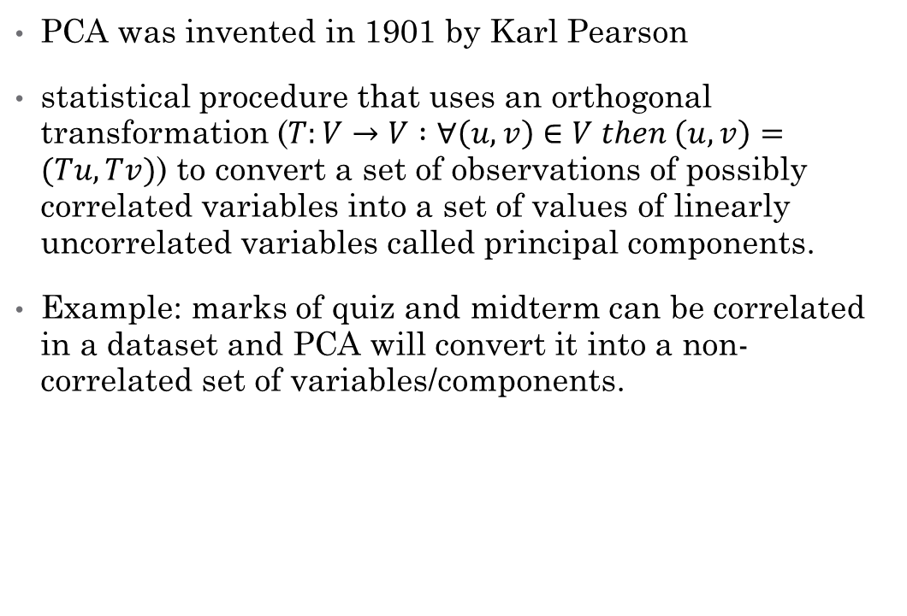
PCA
PCA was invented in 1901 by Karl Pearson
statistical procedure that uses an orthogonal transformation ($T:V→V :∀\left(u,v\right)∈V then \left(u,v\right)=(Tu,Tv)$) to convert a set of observations of possibly correlated variables into a set of values of linearly uncorrelated variables called principal components.
Example: marks of quiz and midterm can be correlated in a dataset and PCA will convert it into a non-correlated set of variables/components.

Slide 15
PCA for Features Reduction
Computation of Covariance Matrix (M)
Compute the Eigen values
Sort the Eigen values
For first k (all non zero) Eigen values
Compute the Eigen vectors
Use the Eigen Vectors as features

Slide 16
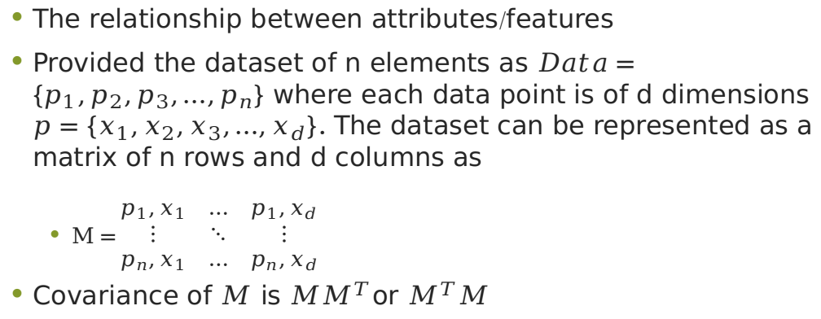
Covariance Matrix
The relationship between attributes/features
Provided the dataset of n elements as $Data=\{p_{1},p_{2},p_{3},…,p_{n}\}$ where each data point is of d dimensions $p=\{x_{1},x_{2},x_{3},…,x_{d}\}$. The dataset can be represented as a matrix of n rows and d columns as
$M=\begin{matrix}p_{1},x_{1} & … & p_{1},x_{d} \\ ⋮ & ⋱ & ⋮ \\ p_{n},x_{1} & … & p_{n},x_{d}\end{matrix}$
Covariance of $M$ is $MM^{T}$or $M^{T}M$

Slide 17
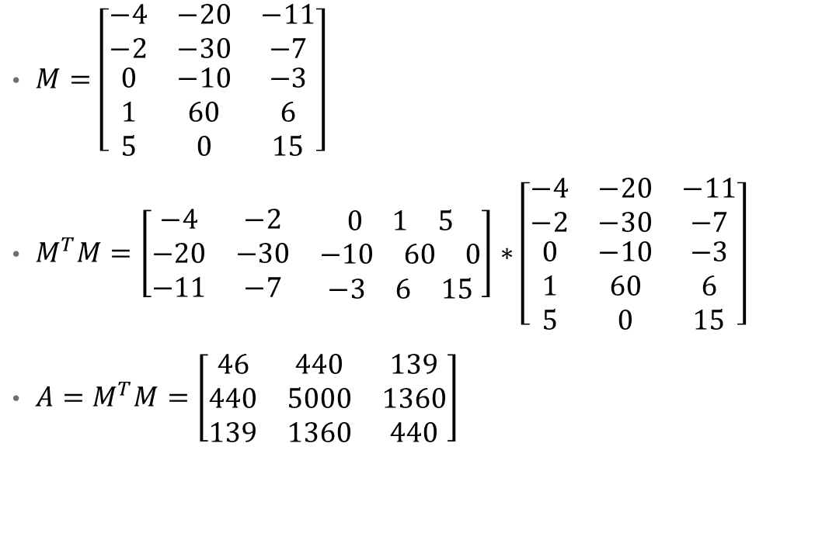
Example
$M=\left[\begin{matrix}−4 & −20 & −11 \\ −2 & −30 & −7 \\ \begin{matrix}0 \\ 1 \\ 5\end{matrix} & \begin{matrix}−10 \\ 60 \\ 0\end{matrix} & \begin{matrix}−3 \\ 6 \\ 15\end{matrix}\end{matrix}\right]$
$M^{T}M=\left[\begin{matrix}−4 & −2 & \begin{matrix}0 & 1 & 5\end{matrix} \\ −20 & −30 & \begin{matrix}−10 & 60 & 0\end{matrix} \\ −11 & −7 & \begin{matrix}−3 & 6 & 15\end{matrix}\end{matrix}\right]∗\left[\begin{matrix}−4 & −20 & −11 \\ −2 & −30 & −7 \\ \begin{matrix}0 \\ 1 \\ 5\end{matrix} & \begin{matrix}−10 \\ 60 \\ 0\end{matrix} & \begin{matrix}−3 \\ 6 \\ 15\end{matrix}\end{matrix}\right]$
$A=M^{T}M=\left[\begin{matrix}46 & 440 & 139 \\ 440 & 5000 & 1360 \\ 139 & 1360 & 440\end{matrix}\right]$

Slide 18

Eigen values
$AV=λV$
A is an n-by-n matrix
V is a non-zero n-by-1 vector
λ is a scalar/eigenvalue
$A=\left[\begin{matrix}a_{11} & … & a_{1n} \\ ⋮ & ⋱ & ⋮ \\ a_{n1} & … & a_{nn}\end{matrix}\right]$
$V=\left[\begin{matrix}v_{1} \\ ⋮ \\ v_{n}\end{matrix}\right]$

Slide 19
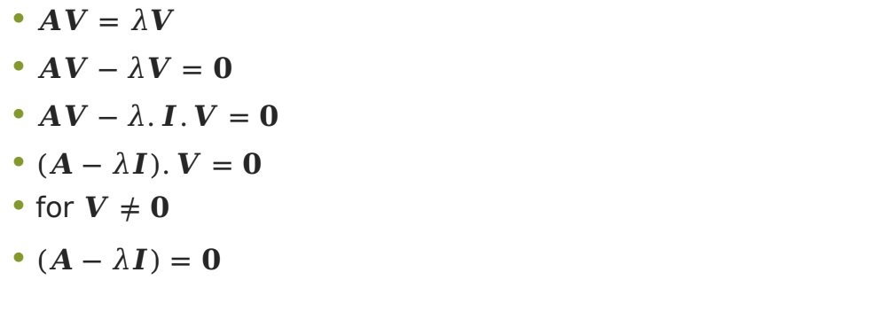
Eigen values
$AV=λV$
$AV−λV=0$
$AV−λ.I.V=0$
$\left(A−λI\right).V=0$
for $V≠0$
$\left(A−λI\right)=0$

Slide 20
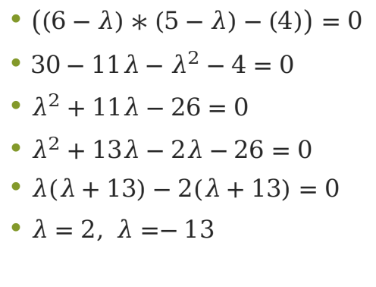
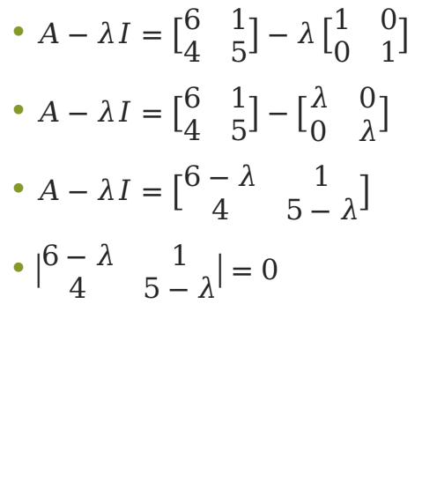
Example
$A−λI=\left[\begin{matrix}6 & 1 \\ 4 & 5\end{matrix}\right]−λ\left[\begin{matrix}1 & 0 \\ 0 & 1\end{matrix}\right]$
$A−λI=\left[\begin{matrix}6 & 1 \\ 4 & 5\end{matrix}\right]−\left[\begin{matrix}λ & 0 \\ 0 & λ\end{matrix}\right]$
$A−λI=\left[\begin{matrix}6−λ & 1 \\ 4 & 5−λ\end{matrix}\right]$
$\left|\begin{matrix}6−λ & 1 \\ 4 & 5−λ\end{matrix}\right|=0$
$\left(\left(6−λ\right)∗\left(5−λ\right)−\left(4\right)\right)=0$
$30−11λ−λ^{2}−4=0$
$λ^{2}+11λ−26=0$
$λ^{2}+13λ−2λ−26=0$
$λ\left(λ+13\right)−2\left(λ+13\right)=0$
$λ=2, λ=−13$

Slide 21
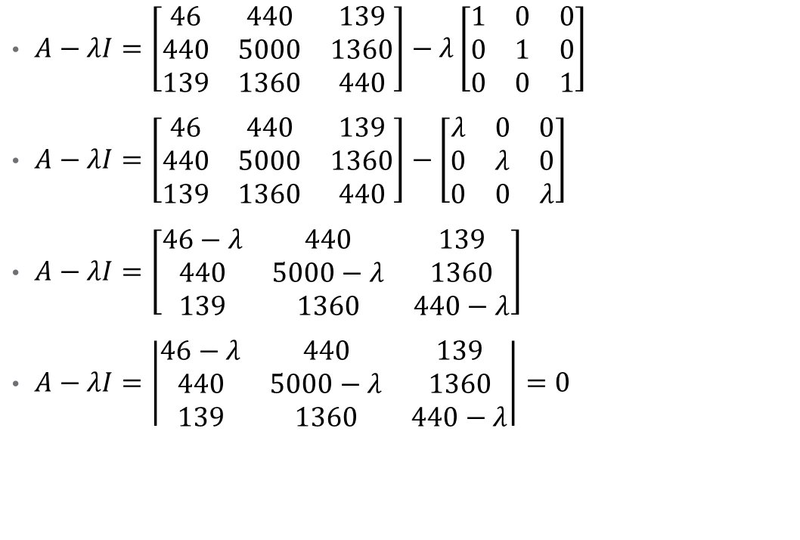
Example: 2
$A−λI=\left[\begin{matrix}46 & 440 & 139 \\ 440 & 5000 & 1360 \\ 139 & 1360 & 440\end{matrix}\right]−λ\left[\begin{matrix}1 & 0 & 0 \\ 0 & 1 & 0 \\ 0 & 0 & 1\end{matrix}\right]$
$A−λI=\left[\begin{matrix}46 & 440 & 139 \\ 440 & 5000 & 1360 \\ 139 & 1360 & 440\end{matrix}\right]−\left[\begin{matrix}λ & 0 & 0 \\ 0 & λ & 0 \\ 0 & 0 & λ\end{matrix}\right]$
$A−λI=\left[\begin{matrix}46−λ & 440 & 139 \\ 440 & 5000−λ & 1360 \\ 139 & 1360 & 440−λ\end{matrix}\right]$
$A−λI=\left|\begin{matrix}46−λ & 440 & 139 \\ 440 & 5000−λ & 1360 \\ 139 & 1360 & 440−λ\end{matrix}\right|=0$

Slide 22

Example: 2
$\left(46−λ\right)\left|\begin{matrix}5000−λ & 1360 \\ 1360 & 440−λ\end{matrix}\right|$
$−\left(440\right)\left|\begin{matrix}440 & 1360 \\ 139 & 440−λ\end{matrix}\right|$
$+(139)\left|\begin{matrix}440 & 5000−λ \\ 139 & 1360\end{matrix}\right|$
...

Slide 23

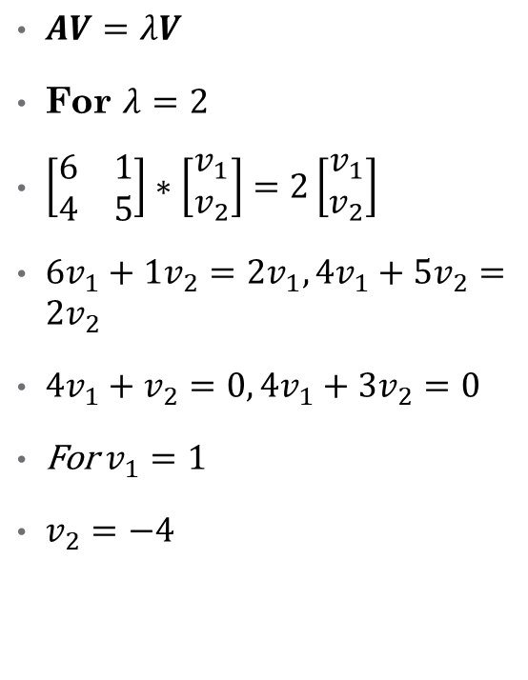
Eigen Vector
$AV=λV$
For $λ=2$
$\left[\begin{matrix}6 & 1 \\ 4 & 5\end{matrix}\right]∗\left[\begin{matrix}v_{1} \\ v_{2}\end{matrix}\right]=2\left[\begin{matrix}v_{1} \\ v_{2}\end{matrix}\right]$
$6v_{1}+1v_{2}=2v_{1},4v_{1}+5v_{2}=2v_{2}$
$4v_{1}+v_{2}=0, 4v_{1}+3v_{2}=0$
For $v_{1}=1$
$v_{2}=−4$
Eigen Vector $e_{1}=\left[\begin{matrix}1 \\ −4\end{matrix}\right]$
The unit vector $e_{1}=\frac{1}{\sqrt{17}}\left[\begin{matrix}1 \\ −4\end{matrix}\right]$
$e_{1}=\left[\begin{matrix}\frac{1}{ \sqrt{\left(17\right)}} \\ −\frac{4}{\sqrt{\left(17\right)}}\end{matrix}\right]$

Slide 24
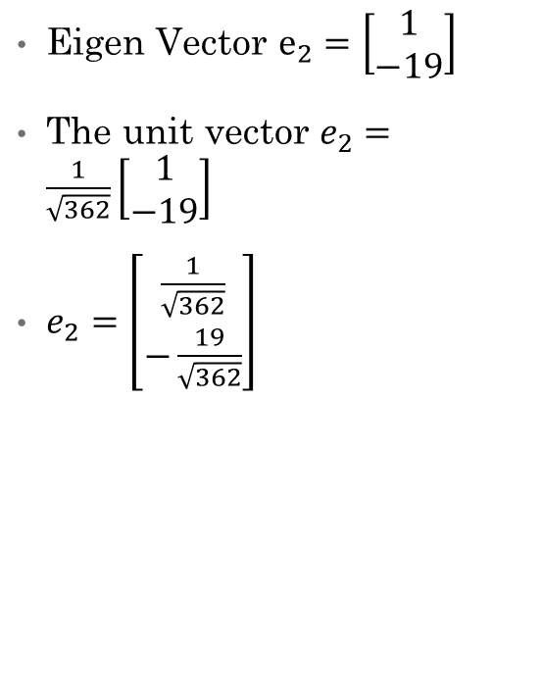
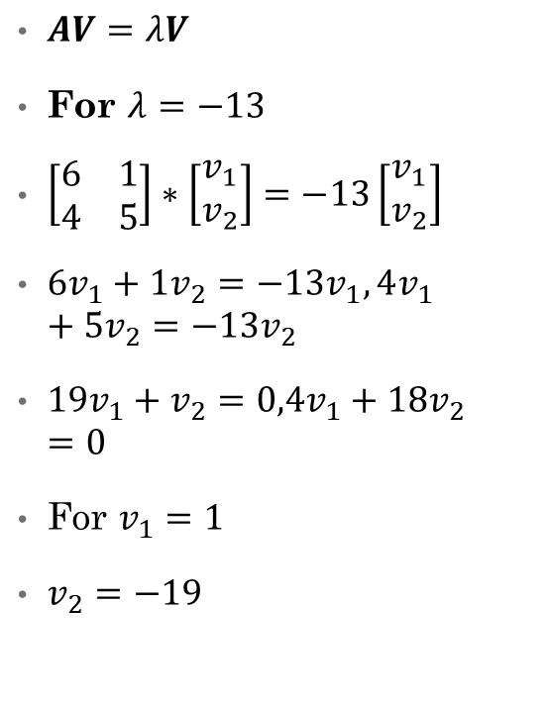
Eigen Vector
$AV=λV$
For $λ=−13$
$\left[\begin{matrix}6 & 1 \\ 4 & 5\end{matrix}\right]∗\left[\begin{matrix}v_{1} \\ v_{2}\end{matrix}\right]=−13\left[\begin{matrix}v_{1} \\ v_{2}\end{matrix}\right]$
$6v_{1}+1v_{2}=−13v_{1},4v_{1}+5v_{2}=−13v_{2}$
$19v_{1}+v_{2}=0,4v_{1}+18v_{2}=0$
For $v_{1}=1$
$v_{2}=−19$
Eigen Vector $e_{2}=\left[\begin{matrix}1 \\ −19\end{matrix}\right]$
The unit vector $e_{2}=\frac{1}{\sqrt{362}}\left[\begin{matrix}1 \\ −19\end{matrix}\right]$
$e_{2}=\left[\begin{matrix}\frac{1}{\sqrt{362}} \\ −\frac{19}{\sqrt{362}}\end{matrix}\right]$

Slide 25

PCA: Feature Vector
Eigen Vector $e_{1}=\left[\begin{matrix}\frac{1}{ \sqrt{\left(17\right)}} \\ −\frac{4}{\sqrt{\left(17\right)}}\end{matrix}\right]$
Eigen Vector $e_{2}=\left[\begin{matrix}\frac{1}{\sqrt{362}} \\ −\frac{19}{\sqrt{362}}\end{matrix}\right]$
Feature Vector $E=\left[\begin{matrix}e_{1} & e_{2}\end{matrix}\right]=\left[\begin{matrix}\frac{1}{ \sqrt{\left(17\right)}} & \frac{1}{\sqrt{362}} \\ \frac{−4}{ \sqrt{\left(17\right)}} & −\frac{19}{\sqrt{362}}\end{matrix}\right]$

